Slide 1
Semantic MediaWiki networked Infrastructure for Text and Data Mining with ISTEX
COLLNET 2016 Nancy

Slide 2
French national initiative
Investments for the future
Investissements d’avenir
Catch word
Documentary excellence for everbody
Equipment
Budget : approximatively 60.000.000 €
Archives and data
target: 50 000 000 documents
At this time: 17 000 000
Springer, Wiley, Elsevier, Oxford University Press…
Various formats: text (OCR), metadata, XML…
A portal is available for French academic people

Slide 3
Two questions:
What can a young researcher do with 10,000 documents related to his thesis topic?
In France, how many librarians and teachers need to be trained: 1,000 ? 10.000 ?
Due to copyright constraints:
How ISTEX could be usefull for the French society ?
How ISTEX could be used servir In the framework of international cooperation?

Slide 4
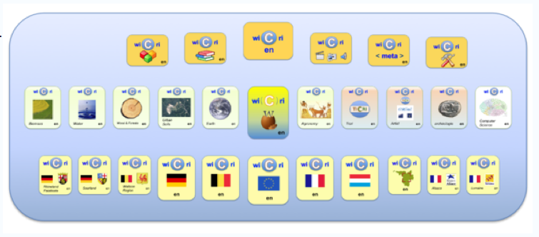
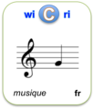
LorExplor: exploring new practices
Text & data mining with time constraints
Co-construction of scientific or cultural portal
Wikis
network
Open sources
ISTEX
Tools
Corpus

Slide 5
Building Knowledge with MediaWiki
MediaWiki : Wikipedia engine
The excellence of the scientific text
In a hypertext landscape
Cyberinfrastructure for collaborative knowledge building (ex Wikipedia)
About electronic documents
A French text from Pouchkine on the music
of Rimsky Korsakov (Mozart and Salieri)
Proceedings
Full text
CIDE
Portal about
electronic docs.
blog
fr

Slide 6
Structuring Knowledge with SMW
Has libretto creator
sur un livret de
[[A pour auteur de livret::Lorenzo da Ponte]].
with a libretto by:
[[Has libretto creator::Lorenzo da Ponte]].
{{#ask:[[a pour auteur de livret::{{PAGENAME}}]]
| format=ul| ?A pour compositeur=compositeur :

Slide 7
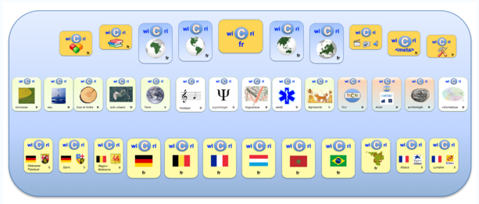
Reading and writing science in an interdisciplinary world
Technical wikis
Thematic wikis
Regional wikis
Associated wikis (worrking groups)
No anonymous !!!! Any registered professional (researcher, practitioner, engineer ...) can contribute to any wiki

Slide 8
Exploration/curation area
Curation steps
Server
Corpus
Streams
Exploration
Server

Slide 9
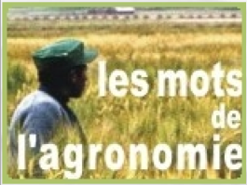
Flexible workshop for corpus exploring
Comercial data
Open access
data
php
Exploration
Curation
Servers
SRI (php)
Terminologies
SRI (php)
Curation
Unix / C… Area
Template (wikitext)
generation
WIKI
Parameters
Curation rules
Visualization
Cooperative work
Wikis
associés
Wikis
institution

Slide 10
Information retrieval - vs –Knowledge exploration
An article by Martin Hatzinger on the death of Mozart?
What is the oldest reference to hypertext? What is the most quoted work of Mozart?
Concerning Kazakhstan:
What are the main cooperations between Lorraine and Kazakhstan?
With which international laboratories can the University of Lorraine ally in order to cooperate with this country?
What are still wild fish that can be domesticated?

Slide 11
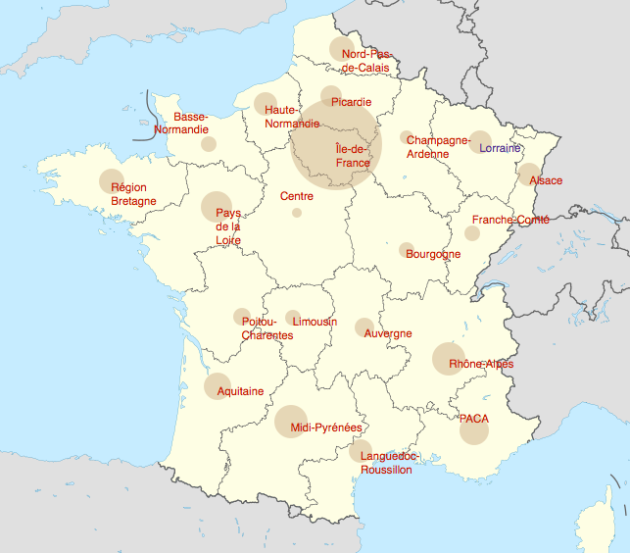
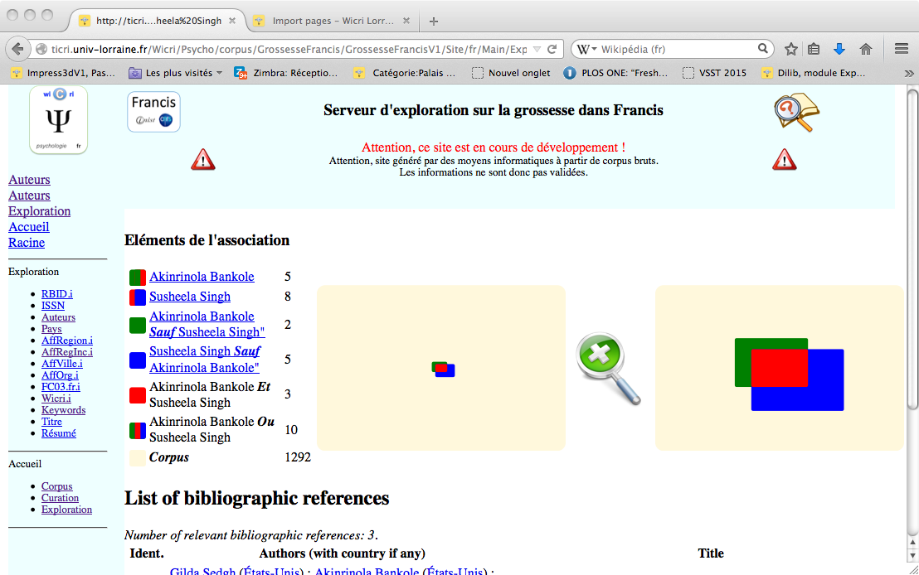
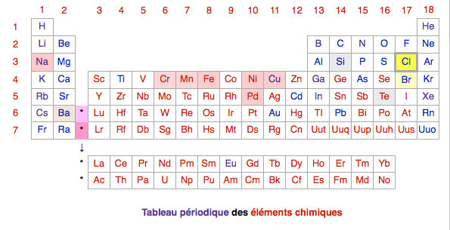
Exploration area and servers
Several servers by stream (curation steps)
Curation

Slide 12
Dilib, an Sxml Toolbox
Sxml
XML light
Unix pipe compatible
a document = a unix line…
1990: Ilib
Needs: ISO 2709 (MARC formats)
SGML with an XML way
A « Lego » for Information retrieval systems
2010 : Dilib 0.5…
Needs: fulltext corpus
Many documents with Many DTD
<index>
<kw>Requiem</kw>
<list>
<item>004321</item>
<item>012345</item>
</list>
<f>2</f>
</index>

Slide 13
Exploration servers Index Browsing with wiki summary
Template
generation

Slide 14
Index combination: AutAff
Author « root name »
Last name + initial
+ Affiliations
Initial objective:
Curation
Homonymies solving
Pragmatic issue: actors discovering

Slide 15
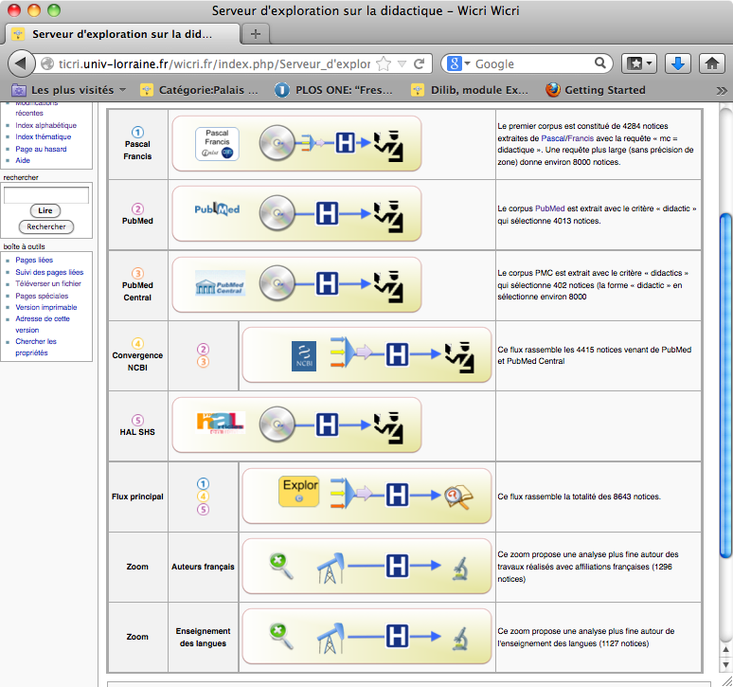
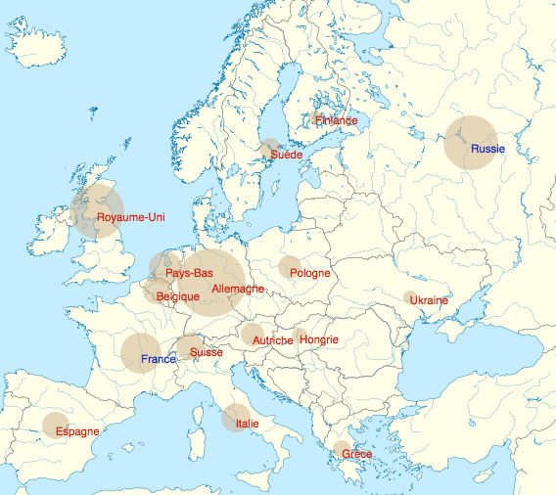
Data curation
First samples: country names in an heterogeneous context

Slide 16
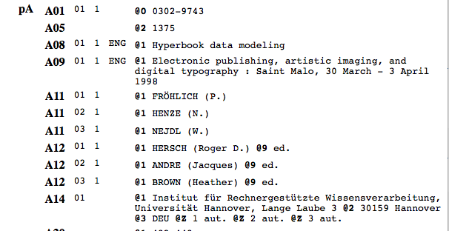
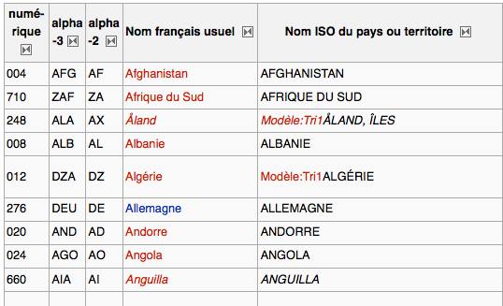
Data curation - countries
Pascal: ISO codes (exemple Pascal)
Wikipedia page adaptation (towards sematic Web)

Slide 17
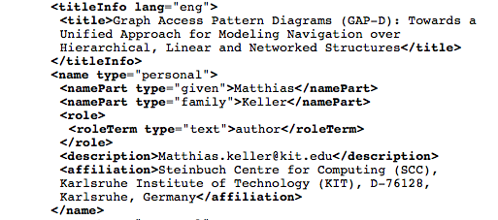
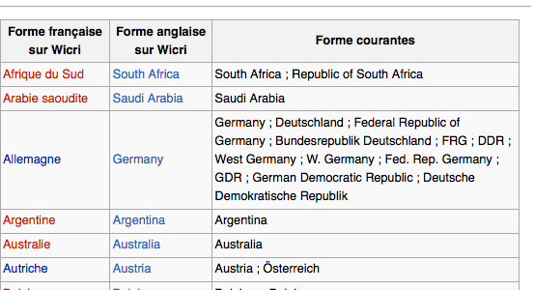
Data curation (countries) Address analysis from wiki tables
(Springer, PubMed)

Slide 18
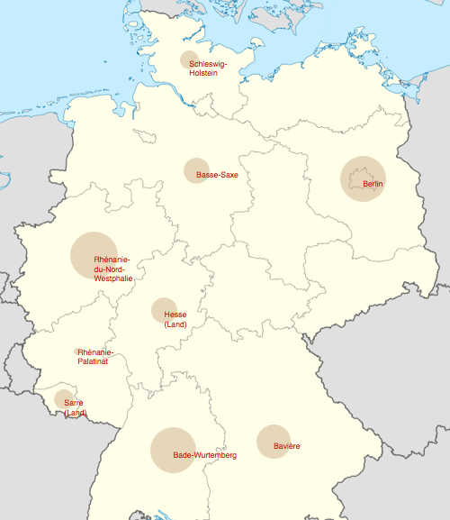
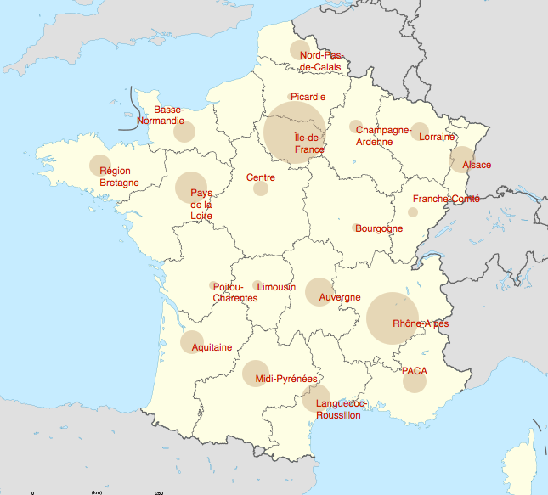
Data curation: region level
These maps could ba available on each servers

Slide 19
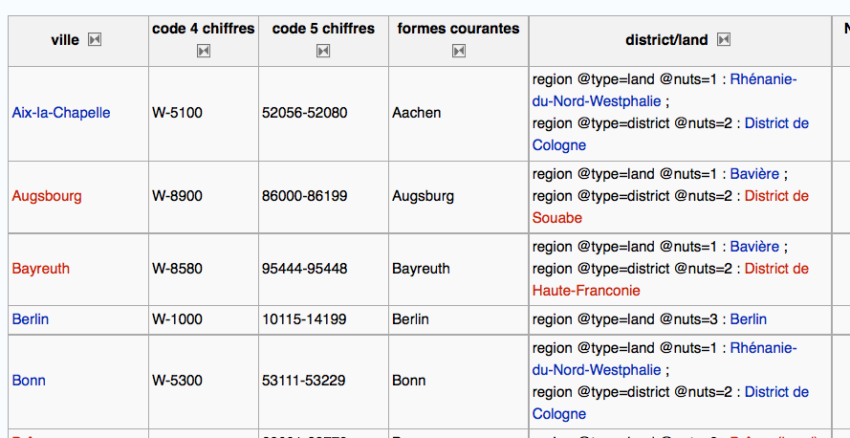
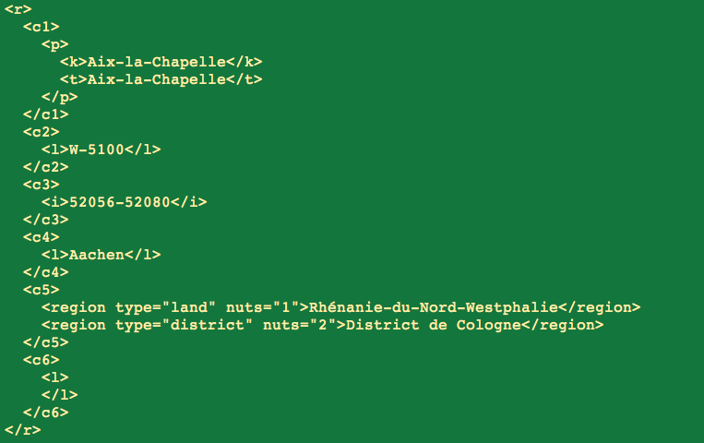
Data curation: region level
Wicri/Allemagne (Wicri/Germany)
Result:
Sxml rules

Slide 20
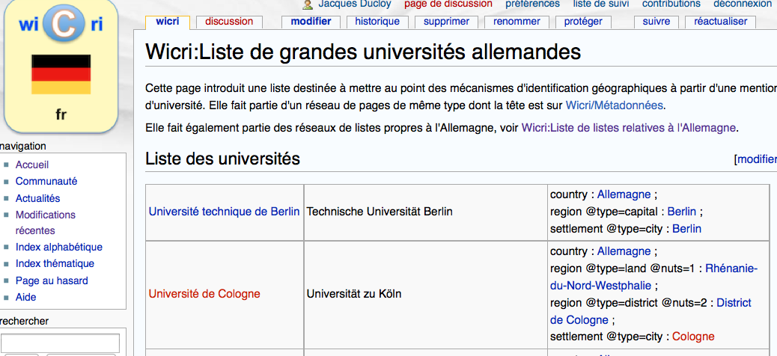
Data curation: region & univ.

Slide 21
Area generation
Iterative process
ISTEX
HAL
PubMed
…
paramètres
Unix engine
Rules

Slide 22
Pairs solving ISTEX / Pascal / Hal / MEDLINE…

Slide 23
Filtering text
Heuristics, an example:
What are the most frequently quoted Mozart works in a corpus ?
General idea: use the Köchel catalog like: Sonata KV. 448
Regular expressions for KV…
HfdCat Data/Main/Exploration/biblio.hfd \
| SxmlFindText -r "[K][Vv]*[ \.]*[0-9][0-9]* » \
| SxmlSelect -p @5 -p @1 | sort | IndexBuildRec
KV.223 000000
KV.125 000000
KV.448 000001
KV.448 000001
KV.025 000002
KV.448 000003
….
…
KV.448 000001
KV.448 000001
KV.448 000003
….
…
<index><k>KV.447</k><n>1</n><l>…
<index><k>KV.448</k><n>500</n><l>…
<index><k>KV.449</k><n>30</n><l>…
….

Slide 24
Filtering text: binomial names
Same tools within different contexts
On Wicri/Water: binomial names
Filtering papers about european fishes:
« perca fluviatilis » « lota lota »…
On Wicri/Music and Wicri/Psychlogy
American Journal of Dance Therapy
What articles have an artistic point of view?
Wikipedia => List of American choreographers
Filtering by « first name » « last name »

Slide 25
A key point with full text corpus: Curation,
Fisrt sample, a corpus about Mozart:
Humanities journals + medical ones:
Humanities: authors without affiliations
Medicine: authors with strong affiliations
Global statistical results deal with medecine!
And not: Music!!!
How to locate items where:
the « Mozart » programming environment
is used to process music data?

Slide 26
OCR: Curation, curation
A test on « Scrum approach »
9,000 documents dealing with Scrum
But 8,000 with OCR errors:
sérum or serum -> scrum

Slide 27
Information science: Curation, curation, curation
Looking for open science in Belgium
4,000 documents for:
"open access" AND belg*
Only between 100 and 200 dealing strongly with open access.
Among the others:
Title:The EADGENE Microarray Data Analysis Workshop (Open Access publication)

Slide 28
Conclusion
Curation
Curation
Curation
Curation
Curation
Curation
Thank you !

